Slide 1
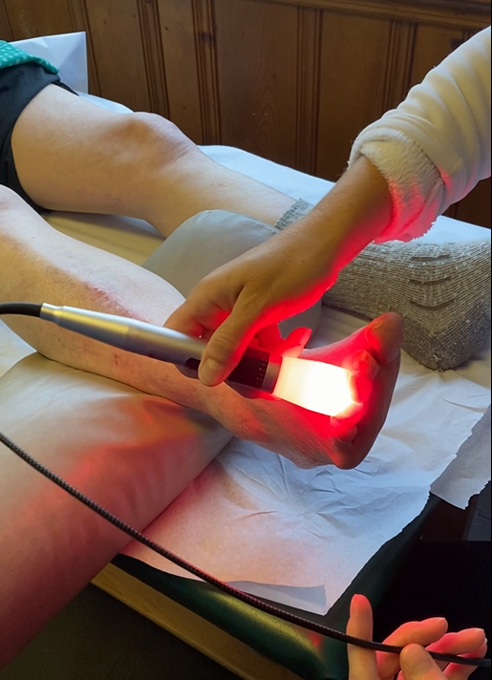
How Summus Laser Can Bring Relief and Healing to Your Neuropathy

Slide 2
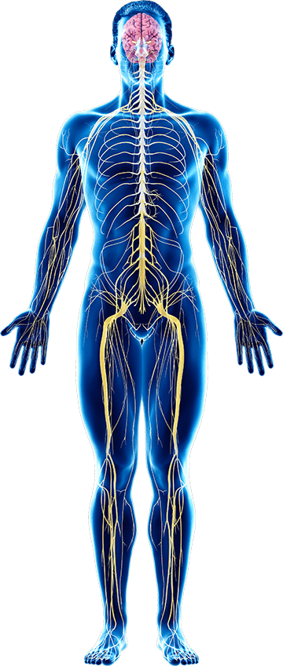
Peripheral Neuropathy
Disease process of the Peripheral Nervous System
CNS
Brain and Spinal Cord
PNS
Nerves outside the CNS
A nerve problem that causes pain, numbness, tingling, swelling, muscle weakness, or dysfunction in different parts of the body.

Slide 3
More than 100 causes of Peripheral Neuropathy
Diabetes ~30-50%
Chemotherapy
Idopathic
Alcoholism
Thyroid
Medications: Statins, some Antibiotics, Blood Pressure meds
Heavy metal toxicity
Trauma
More …

Slide 4
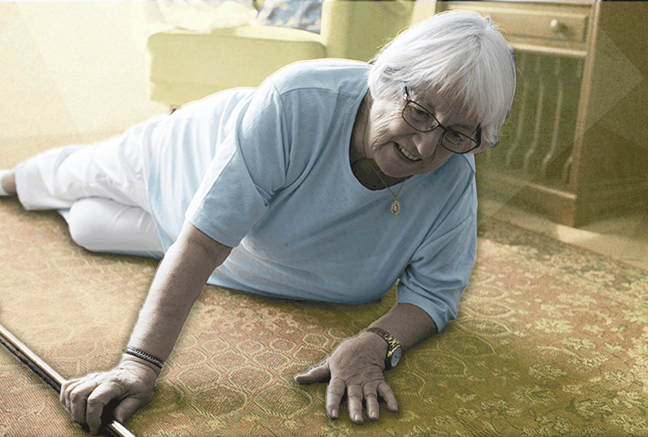
Peripheral Neuropathy is a leading cause of falls.

Slide 5
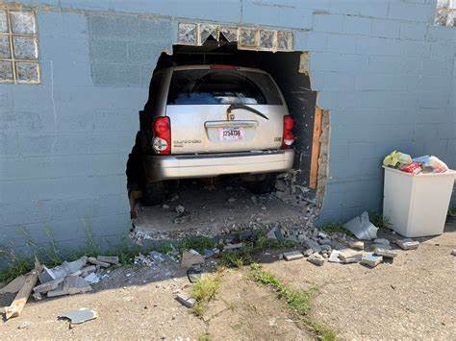
Loss of sensation in feet – cannot feel pedals – lose ability to drive.

Slide 6
Limb Loss Statistics
Approximately 185,000 amputations occur in the United States each year.
300 to 500 per day!
Hospital costs associated with amputation total more than $9 billion.
African‐Americans are up to four times more likely to have an amputation than white Americans.

Slide 7
Nearly half of the individuals who have an amputation due to vascular disease will die within 5 years.
This is higher than the five-year mortality rates for breast cancer, colon cancer, and prostate cancer.
Of persons with diabetes who have a lower extremity amputation, up to 55% will require amputation of the second leg within 2‐3 years.

Slide 8
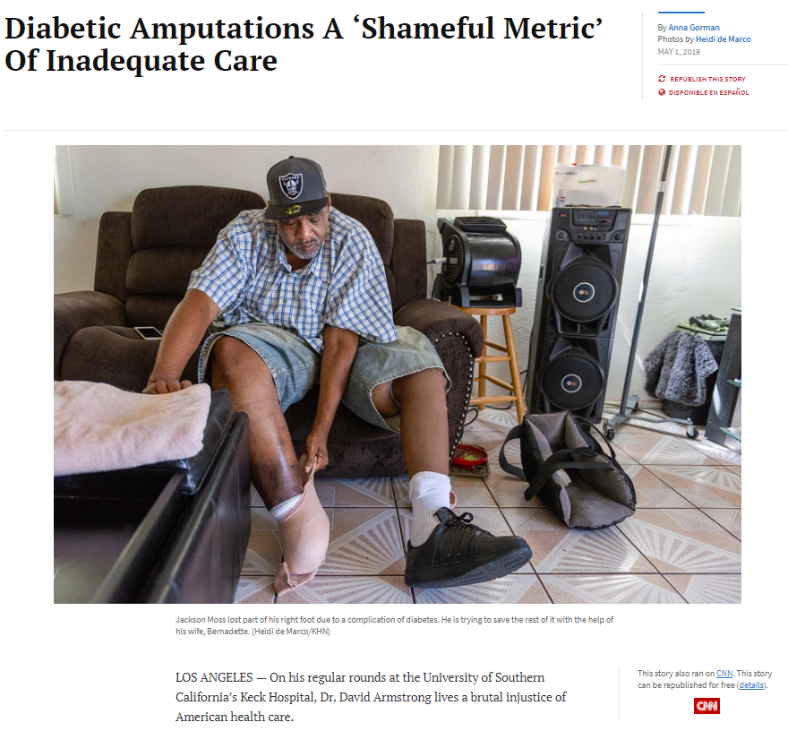
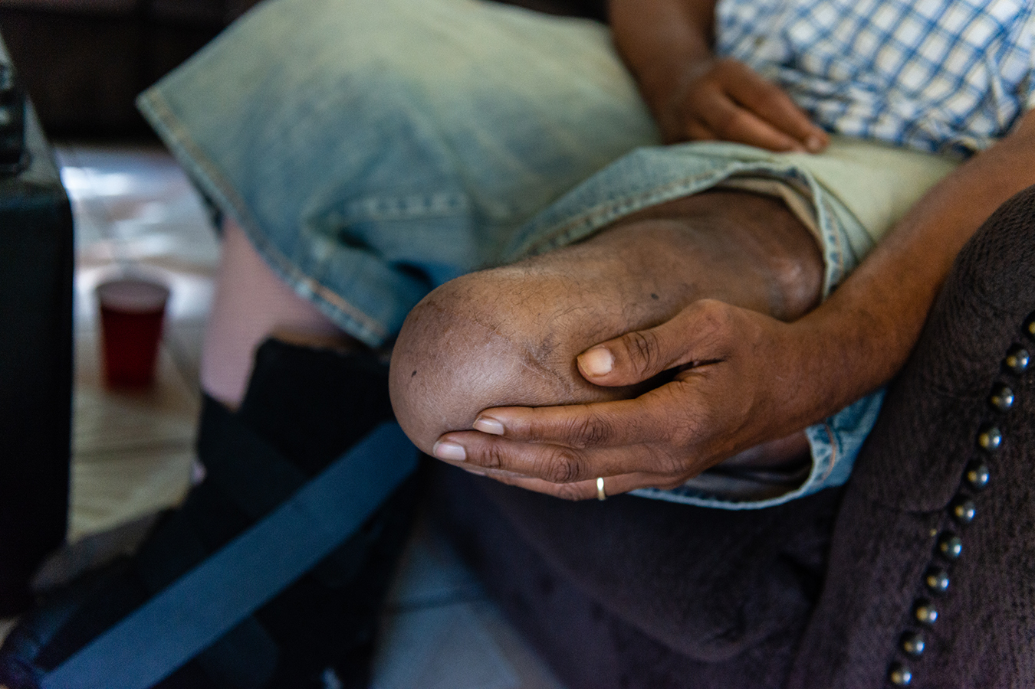
https://khn.org/news/diabetic-amputations-a-shameful-metric-of-inadequate-care/

Slide 9
Your nerves are dead.

Slide 10
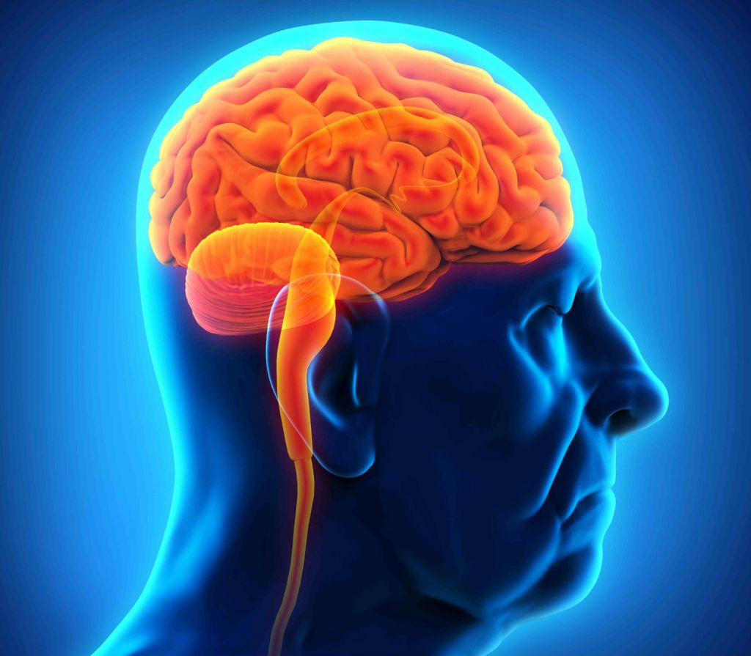
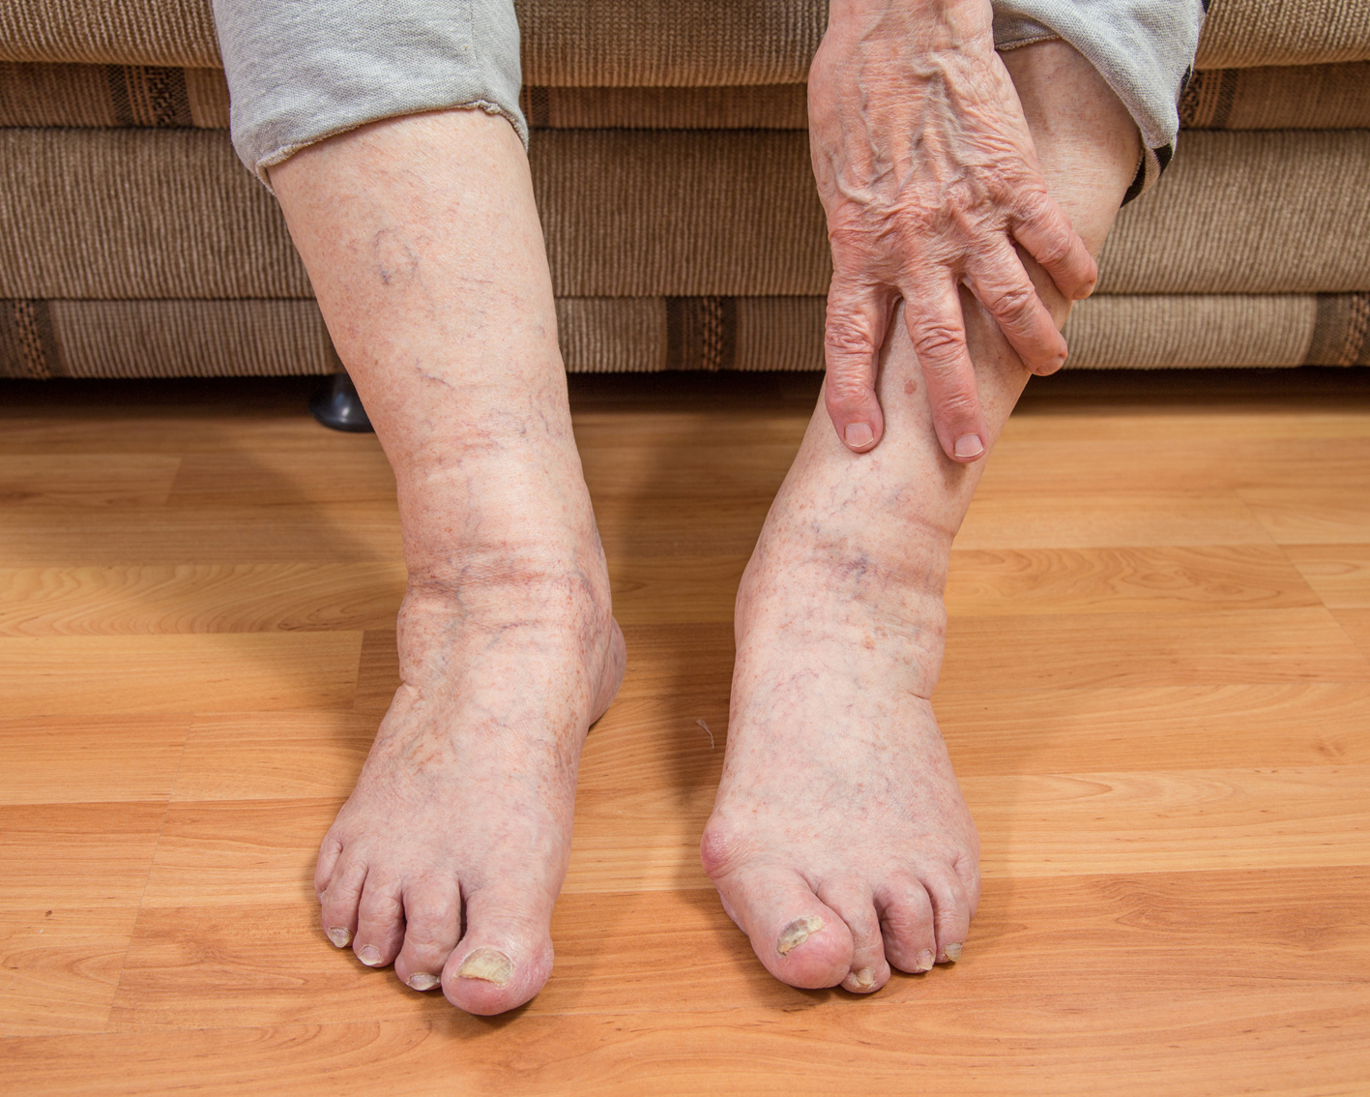
Medication works on the brain Laser works on the legs and feet

Slide 11
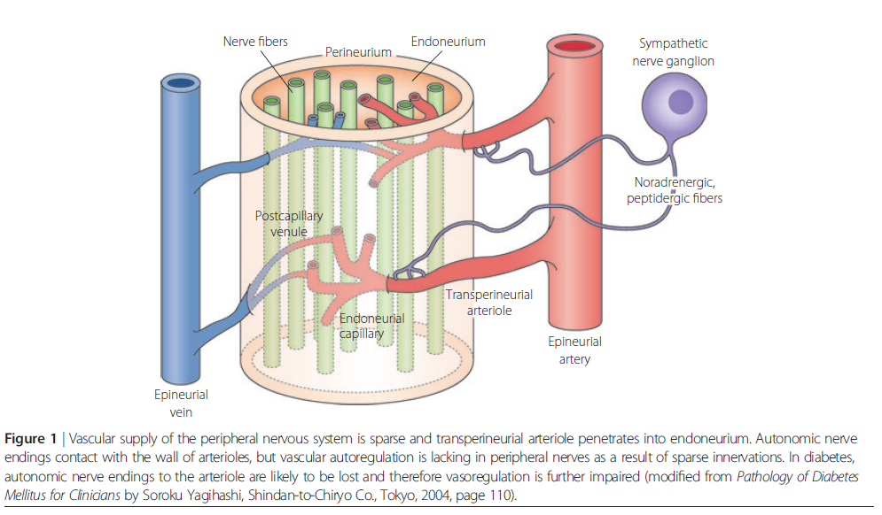
Neuropathy Theories - Vascular
Diabetics – high blood glucose damages lining of blood vessels

Slide 12
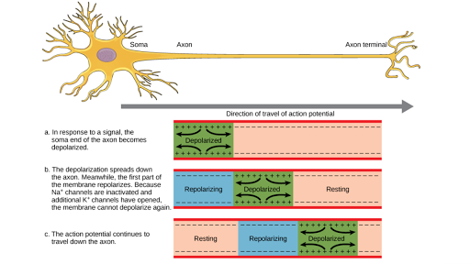
Neuropathy Theories - Depolarization

Slide 13
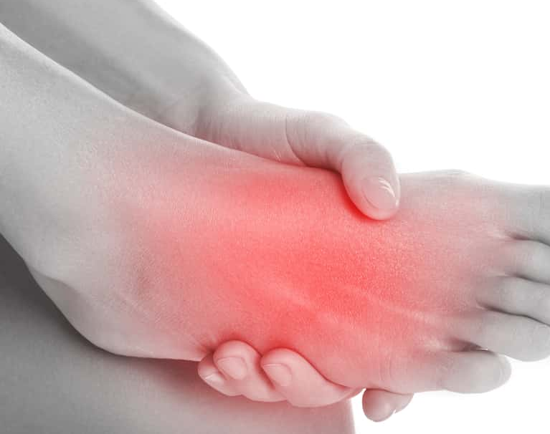
Gradual onset of numbness, prickling or tingling in feet or hands, which can spread upward into legs and arms.
Sharp, jabbing, throbbing, freezing or burning pain
Extreme sensitivity to touch
Difficulty sleeping because of feet and leg pain
Not being able to hold onto something
Notes:
Do Less Better - I would rather you walk away from this meeting with your blade sharpened, and having 3 or 4 extremely effective actions that you can execute on a daily basis that will supercharge your effectiveness… Than have you leave here with a list of 25 things that you think are really really great, and not have you execute on any of them. 25 is too many…
Quotes -

Slide 14
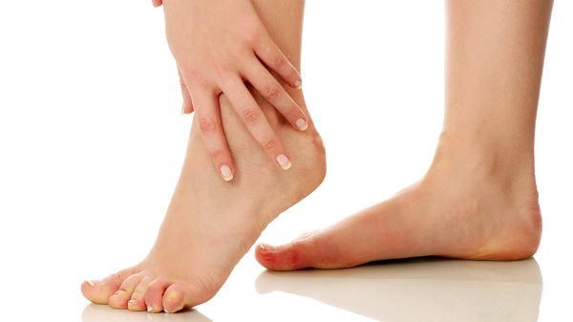
A sensation of wearing an invisible "glove" or "sock"
Not knowing where the feet are
Loss of balance and coordination
Falling
Muscle weakness or paralysis if motor nerves are affected

